Slide 1




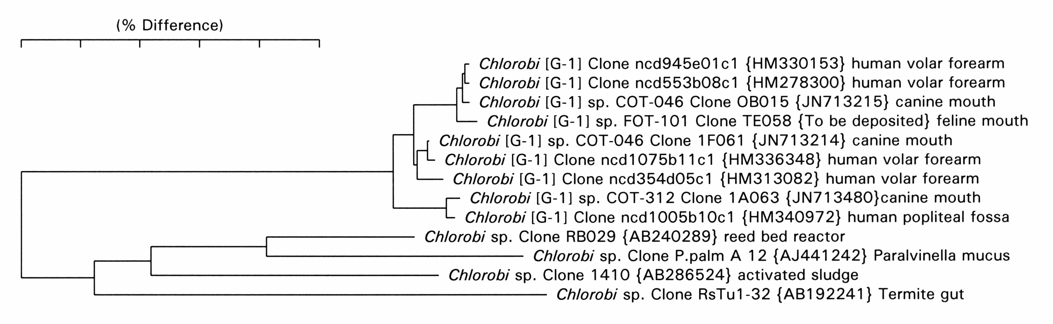
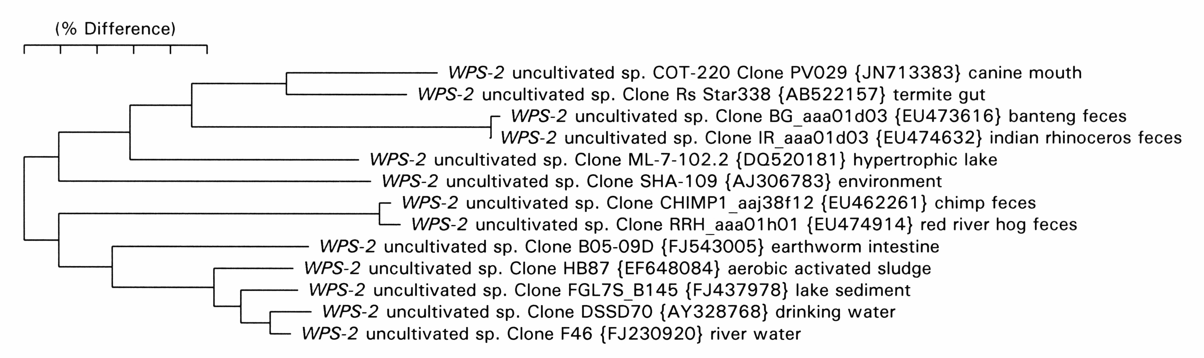
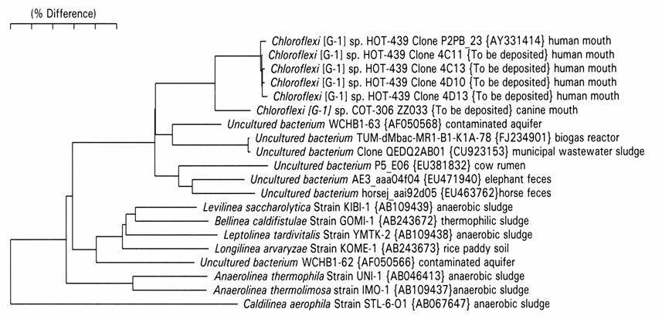
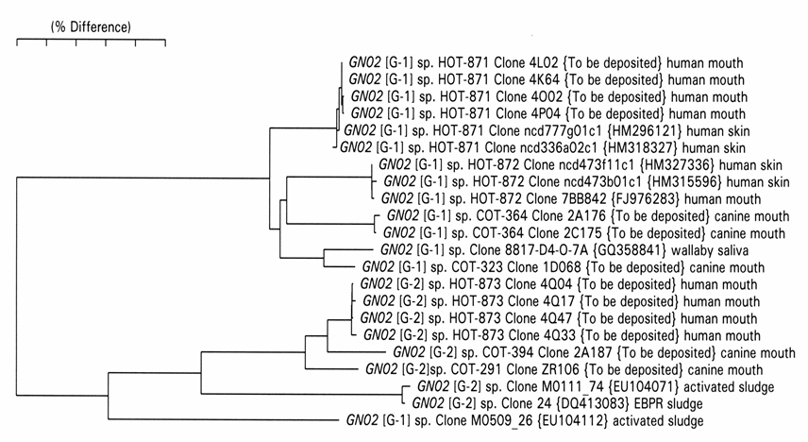
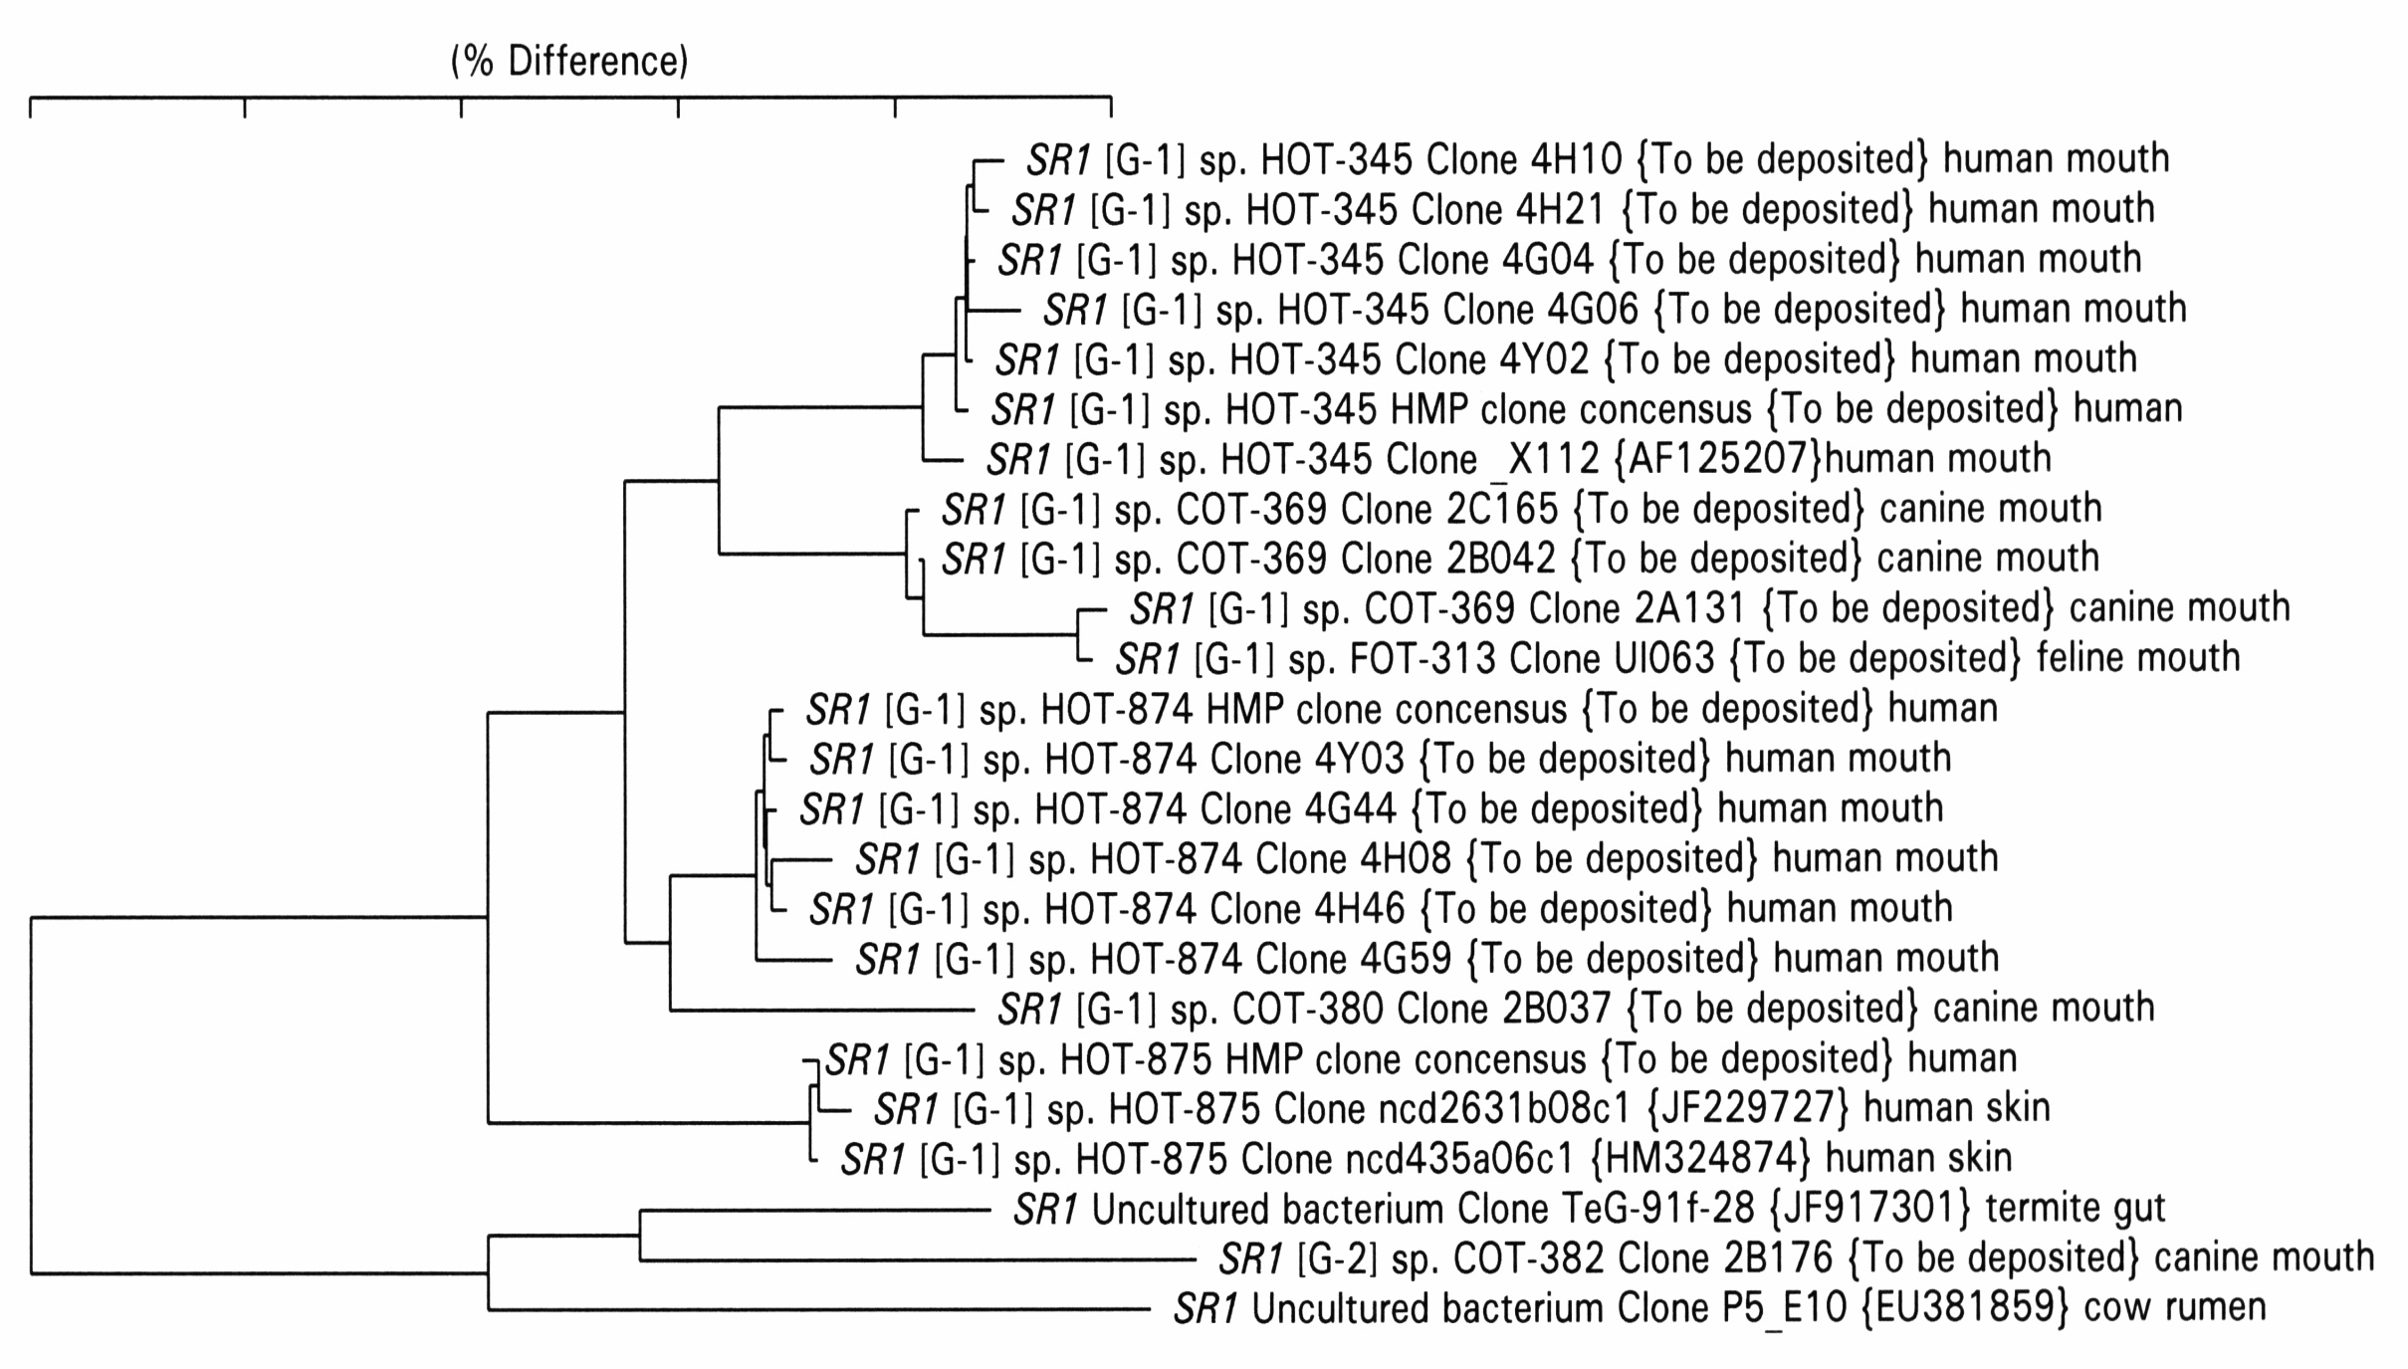

Identification of Oral Taxa from Rare Phyla/Candidate Divisions
Anuj Camanocha and Floyd E. Dewhirst
Harvard School of Dental Medicine , Boston, and The Forsyth Institute, Cambridge, Massachusetts, USA
1119
Anuj
Floyd
Abstract
Figures and Tables
Methods
Results
The majority of taxa in the oral microbiome are members of six well known phyla: Firmicutes, Bacteroidetes, Proteobacteria, Actinobacteria, Spirochaetes, and Fusobacteria. Less commonly encountered phyla include the Tenericutes, Chlamydiae and Synergistetes, and the uncultivated candidate division, TM7.
Objectives: The primary objective of this study was to develop primers for selective PCR amplification and cloning of the 16S rRNA genes from five truly rare phyla/candidate divisions: Chloroflexi, Chlorobi, GN02, SR1, and WPS-2.
Methods: 16S rRNA clone sequences demonstrating the existence of these five phyla/divisions are known from our previous cloning studies (Dewhirst et al. 2010. J. Bacteriol 192:5002-17), the Human Microbiome Project, and unpublished studies of the oral microbiomes of dogs and cats. 16S rRNA sequences from these studies were aligned and used to retrieve additional related sequences from GenBank and Greengenes. Based on aligned sequences from these phyla/divisions with reference sequences from the Human Oral Microbiome Database (HOMD), taxa selective forward and reverse primers were designed heuristically. DNA pools were created from previous oral cloning studies. Probe pairs, including “universal” 9-27F and 1492-1509R and 1525-1541R primers, were tested for amplification of DNA pools. Primer combinations producing amplicons were cloned using TA cloning kits.
Results: Nineteen primers were designed and synthesized. Primer pairs for each of the five phyla/divisions produced an amplicon with at least one oral DNA pool. Twenty-one 16S rRNA libraries were constructed and approximately 50 clones sequenced from each library. Library analysis validated highly specific primer pairs for Chloroflexi, GN02 and SR1. Primer pairs for WPS-2 and Chlorobi produced amplicons for Canine DNA pools but not the two tested human DNA pools.
Conclusions: We have designed highly selective primers for use in analyzing the presence and diversity of five rare oral phyla/divisions, and have identified six previously unrecognized oral taxa. Supported by NIDRC grant DE016937.
DNA purification from clinical samples. Dental plaque from teeth or subgingival periodontal pockets was collected using sterile Gracey curettes. Plaque from the curette was transferred into 100 µl of TE buffer (50 mM Tris-HCl, pH 7.6; 1 mM EDTA). Bacteria on soft tissues were sampled using nylon swabs. The material from the swab was dispersed into 150 µl of TE buffer. DNA extraction was performed using the UltraClean microbial DNA isolation kit (Mo Bio Laboratories, Carlsbad, CA) by following the manufacturer's instructions for the isolation of genomic DNA from Gram-positive bacteria. These samples were collected from both humans and dogs.
16S rRNA gene amplification. Purified DNA samples were amplified with multiple primer sets designed to be selective for Chlorobi, Chloroflexi, GN02, SR1 and WPS-2 16S rRNA genes. PCR was performed in thin-walled tubes using a PerkinElmer 9700 Thermo Cycler. The reaction mixture (50 µl, final volume) contained 10-15 ng of the purified DNA template, 20 pmol of each primer, 40 nmol of deoxynucleotide triphosphates (dNTPs), 2.5 units of Platinum Taq polymerase (Invitrogen, Carlsbad, CA), and 5 µl 10x PCR buffer (200 mM Tris-HCl, pH 8.4; 500 mM KCl). A hot-start protocol was used in which samples were preheated at 94°C for 2 min, followed by amplification using the following conditions: denaturation at 94°C for 45 s, annealing at 60°C for 45 s, and elongation at 72°C for 1 min 30 s, with an additional 1 s for each cycle. Thirty-four cycles were performed, followed by a final elongation step at 72°C for 15 min. Amplicon size and amount were examined by electrophoresis in a 1% agarose gel stained with SYBR Safe DNA gel stain (Invitrogen, Carlsbad, CA) and visualized under UV light. When the visualized product showed a single discrete amplicon of the correct size (~1.5kb), the PCR product was purified using a Qiagen PCR purification kit (Qiagen, Valencia, CA). When the visualized product showed a strong amplicon of the correct size, but had some smearing or multiple bands, a preparative gel was run, and the full-length amplicon band was cut out and DNA purified using a Qiagen gel extraction kit (Qiagen, Valencia, CA).
Cloning procedures. Size-purified 16S rRNA gene amplicons were cloned using a TOPO TA cloning kit (Invitrogen, Carlsbad, CA) by following the manufacturer's instructions. Transformation was performed using competent Escherichia coli TOP10 cells provided by the manufacturer. Transformed cells were plated onto Luria-Bertani agar plates supplemented with kanamycin (50 µg/ml) and incubated overnight at 37°C.
Library screening. 60-100 colonies from each library were used directly as template for colony PCR to amplify the cloned insert with Invitrogen vector M13 (–21) forward and M13 reverse primers. Colonies were picked with a sterile toothpick and dipped into 50 µl reaction mixtures containing 10 pmol each primer, 40 nmol of deoxynucleotide triphosphates (dNTPs), 1.25 units of DNA Taq Polymerase (NEB, Beverly, MA), and 5 µl 10x PCR buffer (200 mM Tris-HCl, 100 mM (NH₄)₂SO₄, 20mM MgSO₄, 1% Triton X-100, 100 mM KCl, pH 8.8,). Electrophoresis on a 1% agarose gel was used to verify the correct amplicon size for 16 clones from each library.
16S rRNA data analysis. Sequence information determined using primer AF37 (positions 521 to 533, reverse) allowed preliminary identification of clones. Clones or strains that appeared to be in the phyla being sought, or whose sequences appeared novel (differing by more than 7 bases from previously identified oral reference sequences in the first 500 bp) were fully sequenced on both strands (approximately 1,540 bases) using 5 additional sequencing primers. Sequences were assembled from the ABI electropherogram files using Sequencher (Gene Codes Corporation, Ann Arbor, MI).
Addition to the Human Oral Microbiome Database. For 16S rRNA gene sequences that did not match named species we created novel 16S rRNA gene-based phylotypes. Phylotypes were defined as a cluster of full-length 16S rRNA gene sequences that have greater than 98.5% similarity to one another and have less than 98.5% similarity to neighboring taxa. Each phylotype was assigned a human oral taxon (HOT) number. Any sequences obtained that had greater than 98.5% 16S rRNA gene sequence similarity to a previously defined phylotype were merged into that phylotype. All sequences were screened for the possibility of being chimeras by Chimera Slayer software (Brian Haas, the Broad Institute [http:// sourceforget.net]).
Primers. Primer pairs designed to be selective for each of the five rare phyla/candidate divisions produced an amplicon with at least one oral DNA pool. Primers are shown in Table 1. The primers in Table 1 with 4 bases in red are variants of a “universal” 1492 reverse primer that has been extended 4 bases into a variable region for specificity (red).
Libraries. A total of twenty-six 16S rRNA libraries were constructed using the primers shown in Table 2. Approximately 50 (44-64) clones were sequenced from each library. Sequencing was done with a reverse primer which annealed at positions 521 to 533, supplying sequencing data for the first 500 bp of each clone. Clones of interest because they represented novel taxa or taxa without good full length reference sequences were fully sequenced. Most of the primer pairs produced clone libraries with only the targeted taxa. However, when a “universal” forward primer was paired with selective reverse primer, libraries of mixed taxa were sometimes produced. Some of these primers are selective even with a universal partner, but are highly specific when both primers are selective.
Human Oral Microbiome Database (HOMD). Clone sequences representing newly recognized taxa were assigned human oral taxon (HOT) numbers and will be included in the HOMD in the next update. Clone sequences from this study as well as sequences from GenBank and Greengenes were entered into an aligned RNA database and used to construct the phylogenetic trees shown in Fig. 1. Novel GN02 taxa HOT-871 to HOT-873 and SR1 taxa HOT-874 and HOT-875 are shown highlighted in red. Human clones for Chlorobi and WPS-2 were not obtained from samples examined, but may be successful on additional samples. Full length reference sequences have been identified for previously known taxa, for example Chloroflexi HOT-439.
Conclusions. This research validated highly specific primer sets for amplification of 16S rRNA genes from Chloroflexi, GN02, and SR1 phyla/candidate divisions. These primer sets can be used in future experiments to identify additional taxa, or to associate the presence or absence of these groups with human health or disease.
Chlorobi
WPS-2
Chloroflexi
Figure 1. Trees for rare taxa.
HOT- ### are human oral taxon numbers. HOT-871 to HOT-875 are newly identified taxa and marked with red dots. Previously know human taxa are indicated with blue dots. COT- and FOT- are canine and feline oral taxon numbers respectively. The scale bare at the top of each panel shows a 5% sequence distance.
Introduction
GN02
References
The primary objective of this study was to develop primers for selective PCR amplification and cloning of the 16S rRNA genes from five truly rare phyla/candidate divisions: Chloroflexi, Chlorobi, GN02, SR1, and WPS-2.
Chlorobi. This phylum has many cultivated species in the class Chlorobea (Overmann and Tuschak 1997). At least 5 other class level clusters of sequences from uncultivated bacteria have been recognized, and now include the cultivated non-photosynthetic organism Ignavibacterium album (Iino, Mori et al. 2010). At the time of this study, three canine oral taxa had been identified. Human skin clones matching these three taxa have been recovered, probably representing human contamination with dog saliva.
Chloroflexi. The phylum Chloroflexi, previously called green non-sulfur bacteria, is found in many environments (Bjornsson, Hugenholtz et al. 2002). Seven class level sub divisions have been recognized, though not all have been formally named. Members of the class ‘Chloroflexi’ are photosynthetic, but characterized members of other classes are not. The human and dog associated phylotypes are members of the class Anaerolineae (Sekiguchi, Yamada et al. 2003), and are most closely related to environmental clone WHCB1-63, AF050566 (92% similarity).
GN02. The candidate division GN02 was first described in a study of the Guerrero Negro hypersaline microbial mat (Ley, Harris et al. 2006). Because clones from this division were found in a study of the canine oral microbiome, it was sought in human oral samples.
SR1. The SR1 division was named for clones identified in a study of microbial streamers on sediment from the Sulphur River in Parkers Cave, Kentucky and was previously included in candidate division OP11 (Harris, Kelley et al. 2004). It is interesting to note that SR1 clone sequences were recovered from deep-groundwater microorganisms which passed through 0.2-micron-pore-size filters (Miyoshi, Iwatsuki et al. 2005). One of the original clones identified in this division was clone X112 from the human oral cavity (Paster, Boches et al. 2001), which is now known as SR1 sp. HOT-345 (Dewhirst, Chen et al. 2010).
WPS-2. The candidate division WPS-2 (Writtenberg Polluted Soil) was first described in a study of polychlorinated biphenyl-polluted soil in Germany (Nogales, Moore et al. 2001). As of July 1, 2011, there were 40 sequences for this division in Greengenes (DeSantis, Hugenholtz et al. 2006). A single clone from a dog has been given the designation COT-220 (JN713383).
Bjornsson, L., P. Hugenholtz, et al. 2002. "Filamentous Chloroflexi (green non-sulfur bacteria) are abundant in wastewater treatment processes with biological nutrient removal." Microbiol 148: 2309-2318.
DeSantis, T. Z., P. Hugenholtz, et al. 2006. "Greengenes, a chimera-checked 16S rRNA gene database and workbench compatible with ARB." Appl Environ Microbiol. 72: 5069-5072.
Dewhirst, F. E., T. Chen, et al. 2010. "The human oral microbiome." J. Bacteriol. 192: 5002-5017.
Harris, J. K., S. T. Kelley, et al. 2004. "New perspective on uncultured bacterial phylogenetic division OP11." Appl Environ microbiol. 70(2): 845-849.
Iino, T., K. Mori, et al. 2010. "Ignavibacterium album gen. nov., sp. nov., a moderately thermophilic anaerobic bacterium isolated from microbial mats at a terrestrial hot spring and proposal of Ignavibacteria classis nov., for a novel lineage at the periphery of green sulfur bacteria." Int J Syst Evol Microbiol. 60: 1376-1382.
Ley, R. E., J. K. Harris, et al. 2006. "Unexpected diversity and complexity of the Guerrero Negro hypersaline microbial mat." Appl Environ Microbiol. 72: 3685-3695.
Miyoshi, T., T. Iwatsuki, et al. 2005. "Phylogenetic characterization of 16S rRNA gene clones from deep-groundwater microorganisms that pass through 0.2-micrometer-pore-size filters." Appl Environ Microbiol. 71: 1084-1088.
Nogales, B., E. R. Moore, et al. 2001. "Combined use of 16S ribosomal DNA and 16S rRNA to study the bacterial community of polychlorinated biphenyl-polluted soil." Appl Environ Microbiol. 67: 1874-1884.
Overmann, J. and C. Tuschak 1997. "Phylogeny and molecular fingerprinting of green sulfur bacteria." Arch microbiol. 167: 302-309.
Paster, B. J., S. K. Boches, et al. 2001. "Bacterial diversity in human subgingival plaque." J Bacteriol. 183: 3770-3783.
Sekiguchi, Y., T. Yamada, et al. 2003. "Anaerolinea thermophila gen. nov., sp. nov. and Caldilinea aerophila gen. nov., sp. nov., novel filamentous thermophiles that represent a previously uncultured lineage of the domain Bacteria at the subphylum level." Int J Syst Evol Microbiol. 53: 1843-1851.
SR1
QRC Download a copy of the poster

